Slide 1


Data
Analysis

Slide 2


Today's agenda
Project recap
Problem
The Analytics team
Process
Insights
Summary

Slide 3

Social Buzz is a fast growing tech unicorn that need to adapt quickly to its global scale. Accenture has begun a 3 month POC focusing on these tasks:
An audit of their big data practice
Recommendations for a successful IPO
Analysis to find Social Buzz’s top 5 most popular categories of content
Project Recap

Slide 4


Problem
Over 100,000 posts a day
36,500,000 pieces of content per year!
But how to capitalize on it when there is so much?
Analysis to find Social Buzz’s top 5 most popular categories of content

Slide 5



Andrew Fleming
Chief Technical Architect
The Analytics Team
Marcus Rompton
Senior Principle
Atin Mahajan
Data Analyst

Slide 6
Process
1
Data Understanding
2
Data Cleaning
3
Data Modelling
4
Data Analysis
5
Uncover Insights

Slide 7

Insights
16
1897
May
UNIQUE CATEGORIES
REACTIONS TO “ANIMALS” POSTS
MONTH WITH MOST POSTS

Slide 8
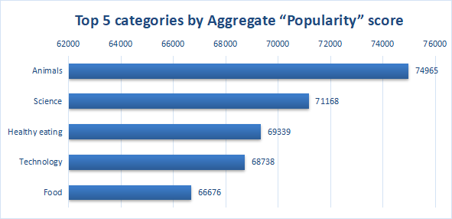

Slide 9
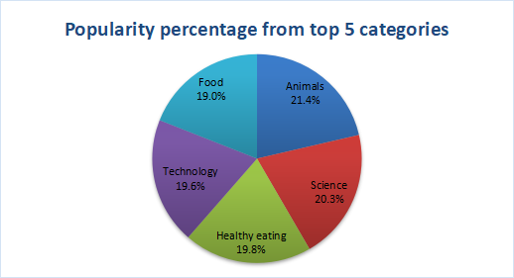

Slide 10
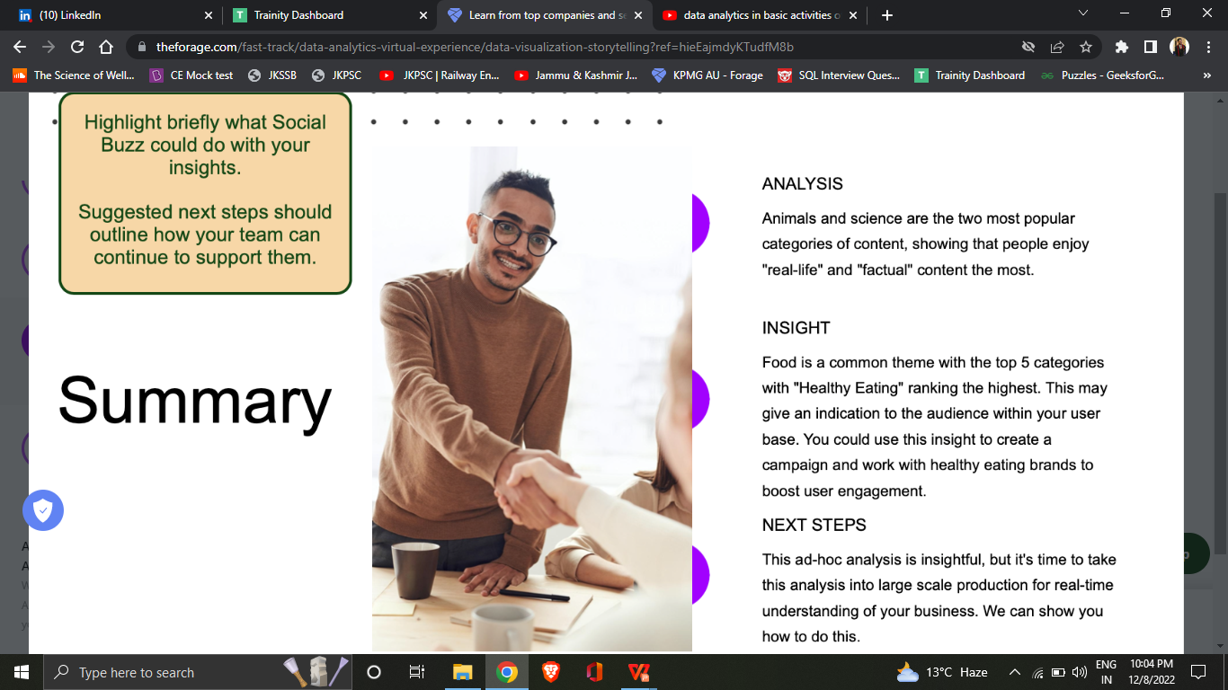

Social Buzz’s top 5 most popular categories of content :
Animals
Science
Healthy Eating
Technology
Food
Summary

Slide 11

Thank you!
ANY QUESTIONS?

